Slide 1
Employee Attrition
Author:
Shikha Kala

Slide 2
Executive Summary
Predicting Employee Attrition with Machine Learning
Challenge: High attrition drives recruitment costs, productivity loss, and expertise drain.
Approach: Applied ML models (Logistic Regression, Decision Trees, Random Forest, SVM, AdaBoost) with SHAP analysis for interpretability.
Key Insights: Job satisfaction, salary, and tenure are top attrition drivers.
Impact: Enables HR to implement data-driven retention strategies, reducing turnover costs and improving engagement.

Slide 3
Data Pre-processing Overview
Handled Missing & Invalid Data
Removed missing values and duplicates.
Dropped records with invalid ApplicationID.
Data Transformation
Converted categorical columns to integers.
Removed non-informative columns (e.g., StandardHours, EmployeeCount).
Encoded target variable:
0 → Current Employee
1 → Voluntary Resignation
Final Dataset
Clean, structured, and ready for model training.

Slide 4
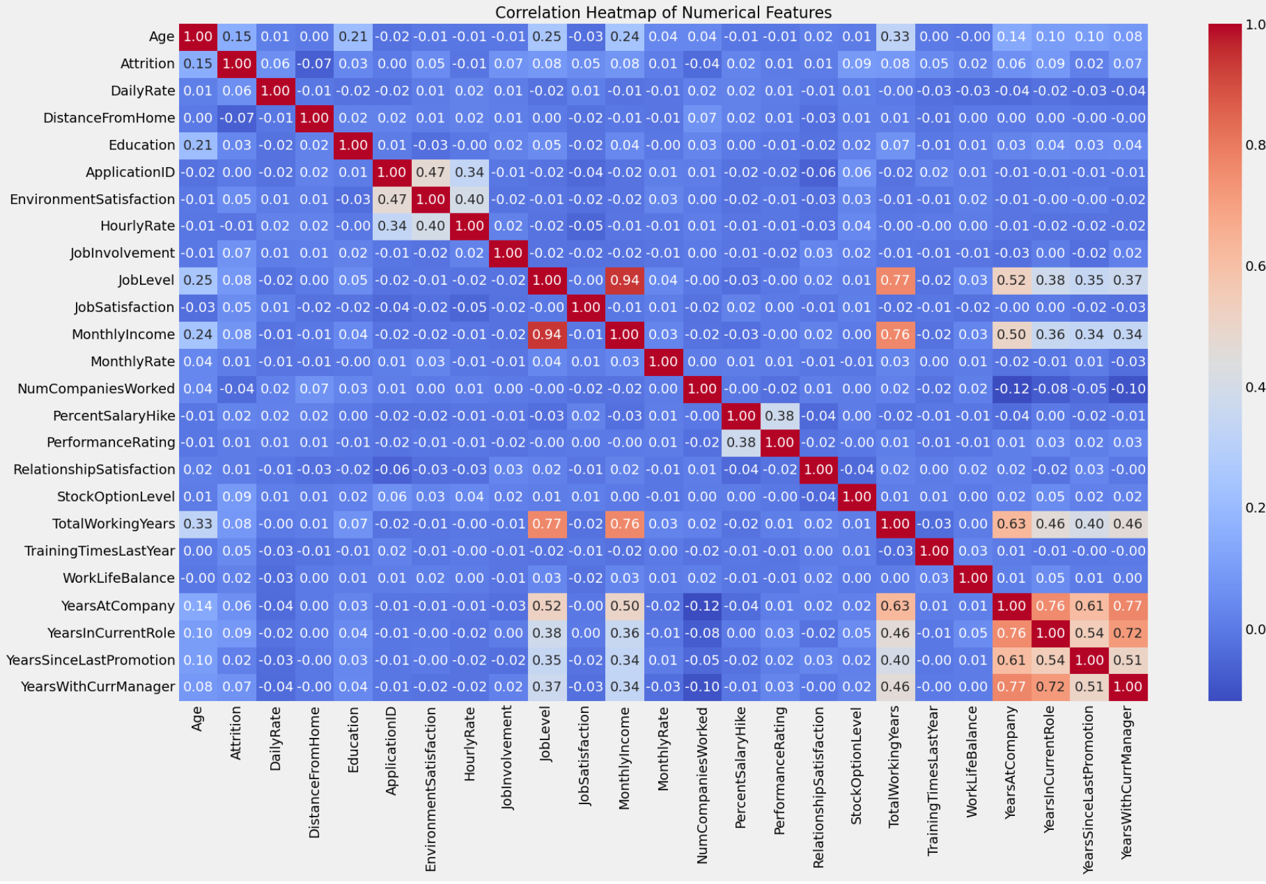
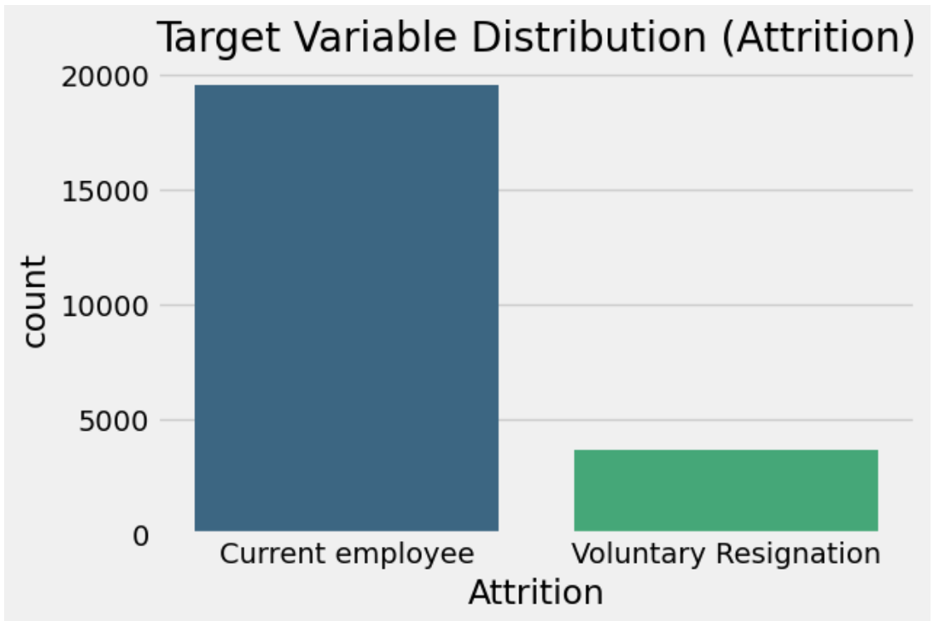
EDA Insights
Target variable analysis (imbalance data)

Slide 5
EDA Insights (Ctd.)
Attrition Trends
Significant class imbalance—more current employees than those who resigned.
Younger, lower-level employees with lower income had higher attrition.
Job-hopping history linked to higher resignation rates.
Salary & Job Level Impact
Higher-income employees stayed longer.
Job Level and Monthly Income highly correlated (~0.94).
Lower job levels had higher attrition, likely for better opportunities.
Work-Life Balance & Job Satisfaction
Minimal impact on attrition—employees left for better pay/career growth.
Job satisfaction wasn’t a strong predictor of attrition.

Slide 6
EDA Insights (Ctd.)
Promotions & Career Growth
Long stagnation in a role increased attrition.
Years Since Last Promotion had little effect—employees left for growth, not just promotions.
More experienced employees were less likely to leave.
Managerial Influence
Short tenure under a manager correlated with higher attrition.
Strong long-term manager relationships improved retention.
Other Key Findings
Overtime work increased attrition (burnout factor).
Employees hired via referrals had the lowest attrition.
Frequent travelers left more, likely due to stress.
Sales Executives & Lab Technicians had the highest attrition—need targeted retention.

Slide 7
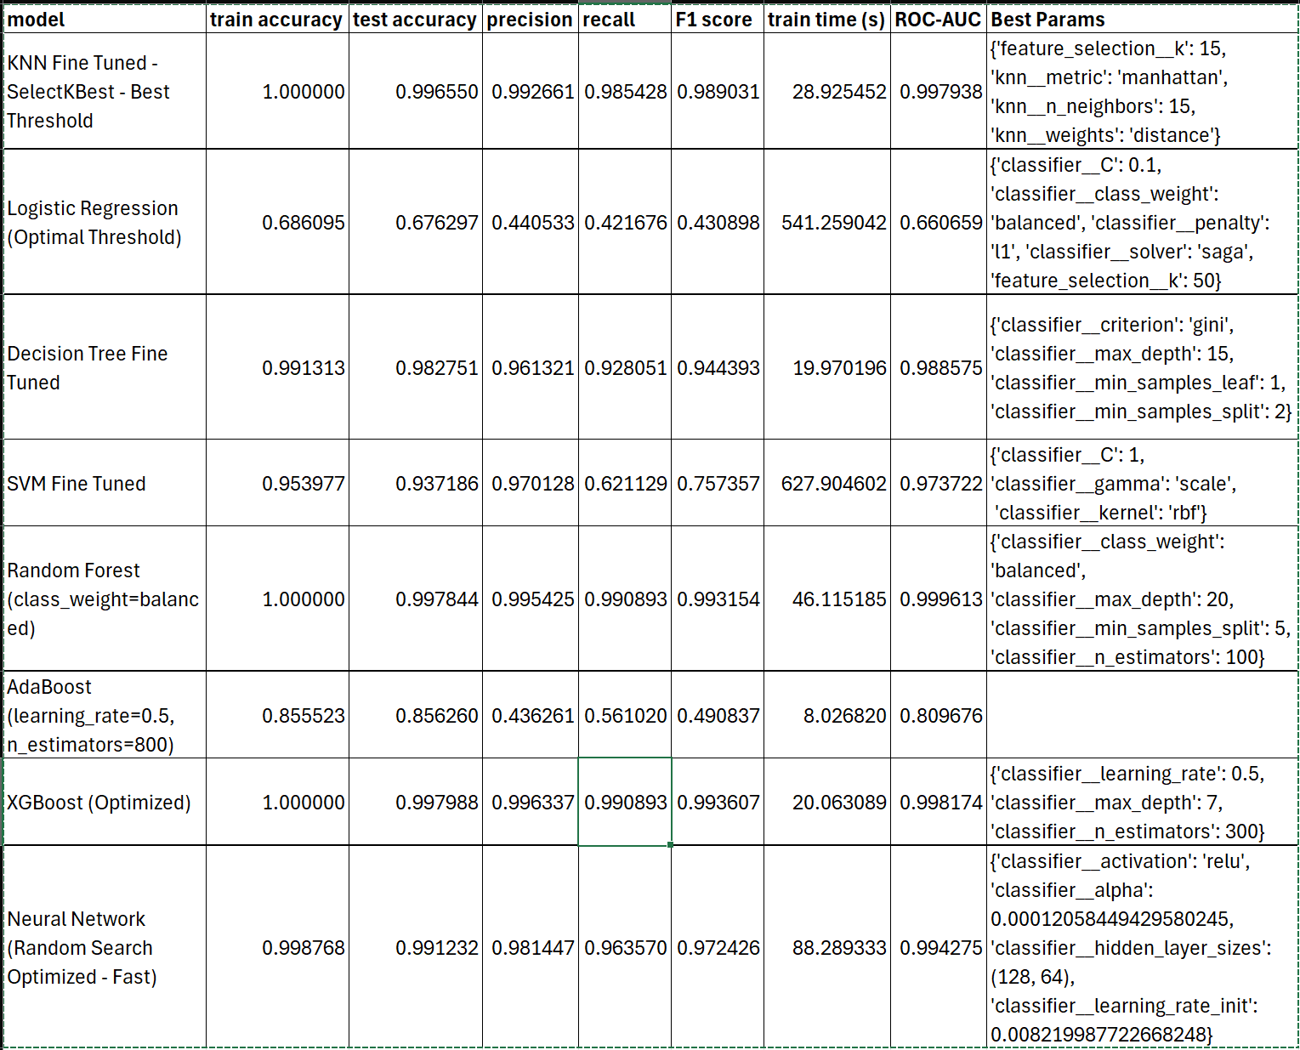
Modeling Results

Slide 8
Modeling Results (Ctd.)
Best Model: Random Forest (class_weight=balanced)
Test Accuracy: 99.78%
F1 Score: 0.9932 (Highest F1)
ROC-AUC: 0.9996 (Near-perfect class separation)
Precision: 0.9954 | Recall: 0.9909
Train Time: 46.1s (Efficient for performance)
Why?
Balanced precision & recall
Handles class imbalance well
Prevents overfitting with class weighting
Best Alternative: XGBoost (Optimized)
Near-perfect generalization, faster training time
Other Notable Mentions
KNN Fine Tuned - SelectKBest - Best Threshold
High accuracy but computationally expensive at test time
Neural Network (Fast Optimized)
Strong performance but high training cost

Slide 9
Next Steps and Recommendations
Boost Compensation & Career Growth – Competitive pay, clear promotion paths.
Improve Work-Life Balance – Limit overtime, offer flexible work options.
Strengthen Leadership & Engagement – Train managers, improve mentorship.
Refine Hiring & Retention – Focus on high-attrition roles, adjust travel policies.
Leverage Data Insights – Use ML models to predict and prevent attrition.
Impact: Lower turnover, higher engagement, reduced hiring costs.

Slide 10
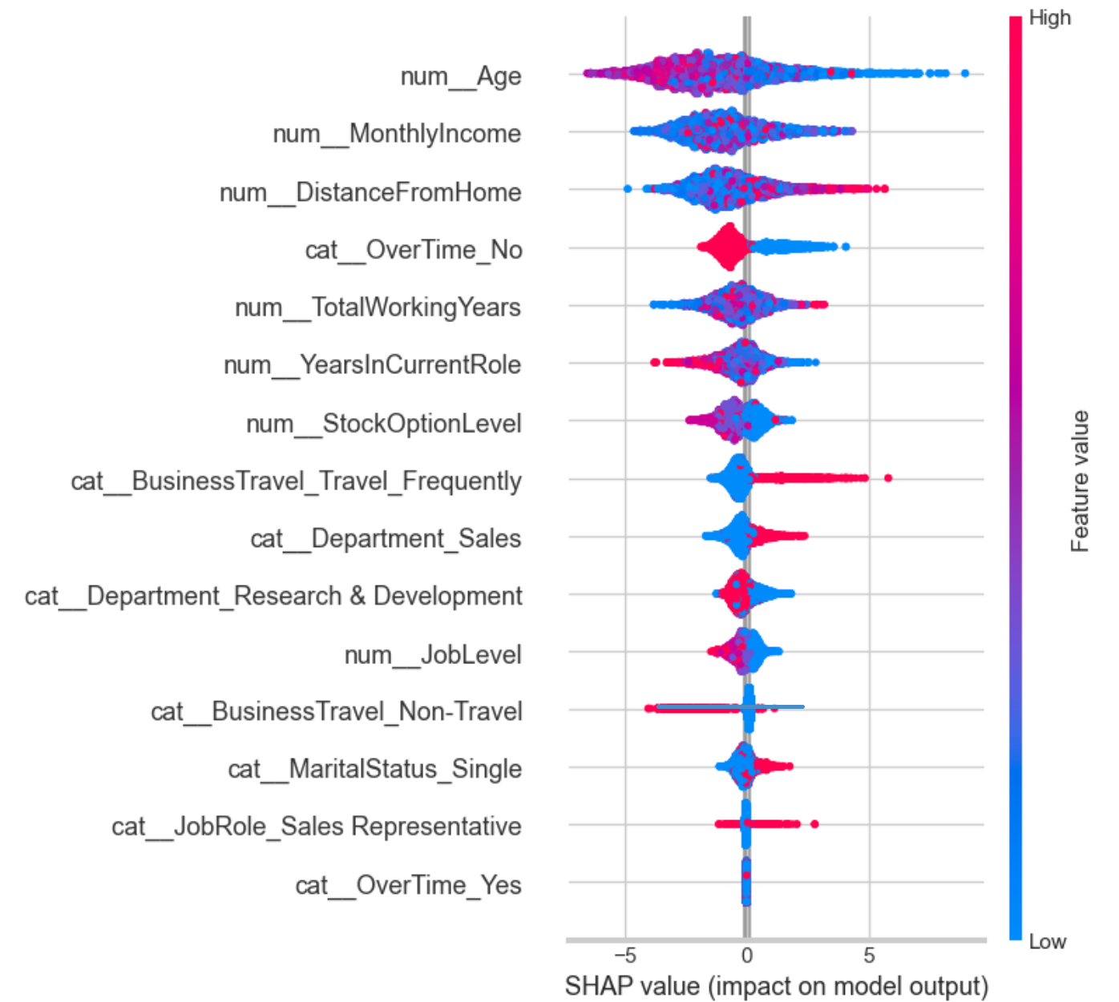
Appendix
SHAP Analysis

